Slide 1
Worcester Together
2026 Q1 Report
Compiled by CHGW Research & Evaluation Subcommittee
WT Health and Wellness Response Group
Center for Food Equity
WT Housing Response Group
WT Immigrant and Refugee Response Group
Presented May 07, 2026
18 Chestnut Street, Worcester, MA 01608

Slide 2
MassHealth Overview
Sources: MA EOHHS
U.S. Census Bureau
ACS 5 Year Estimates 2020-2024
Mass.Gov Feb 2026 OB3 Impact Report

Slide 3
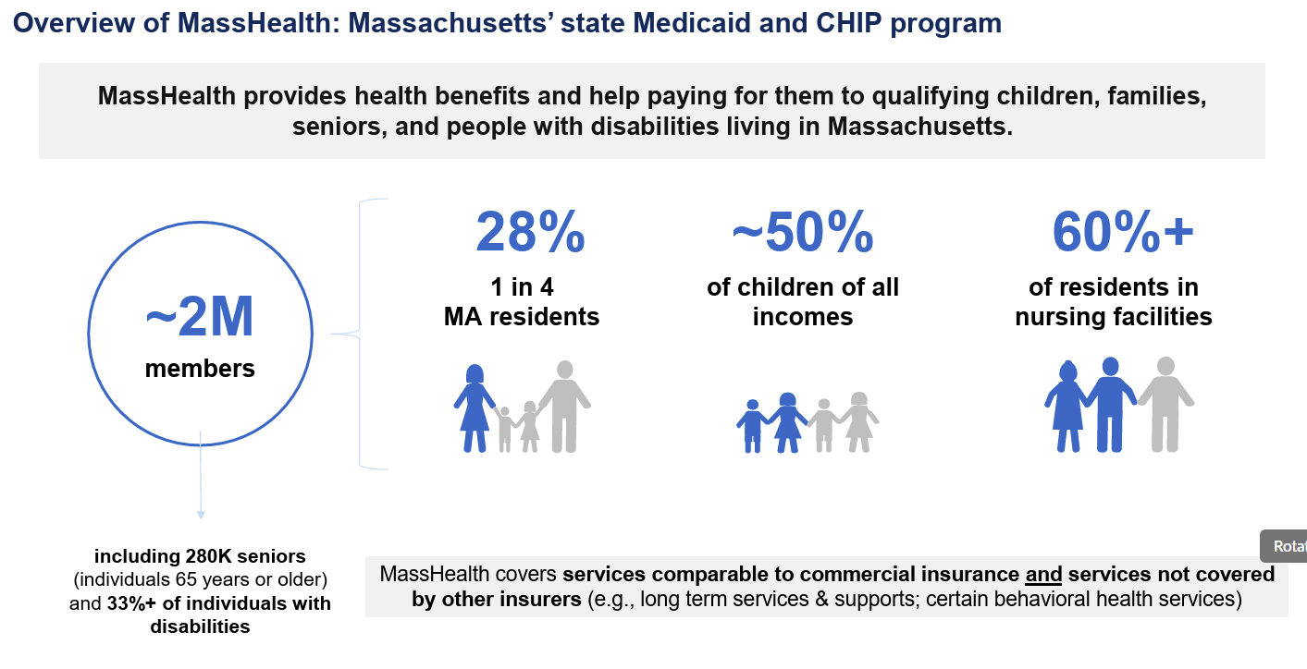
From Mass.Gov Feb 2026
Source: Impact of OB3 on MassHealth for Stakeholders & Partners - Feb 2026.pdf

Slide 4
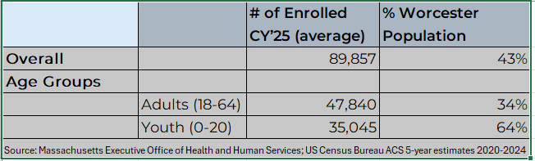
MassHealth Enrollment among Worcester Residents
Overall, an estimated 43% of Worcester residents are enrolled in Masshealth, permanently or temporarily
Approximately 34% of adults 18-64 years are members
Approximately 64% of youth 0-20 years are members

Slide 5
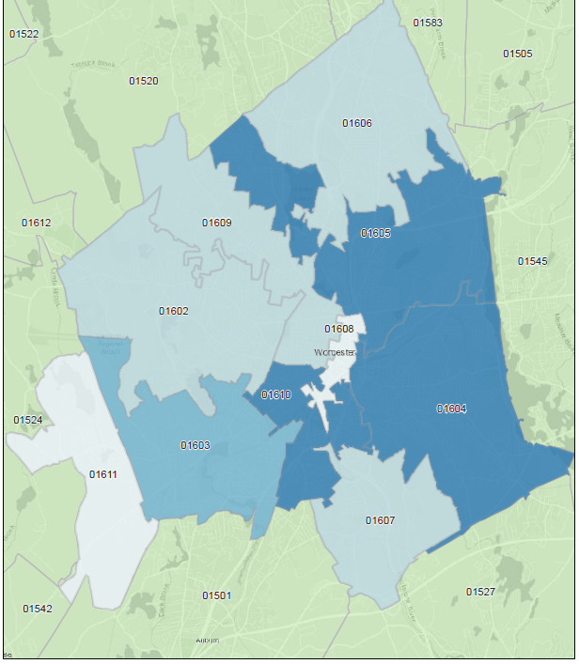
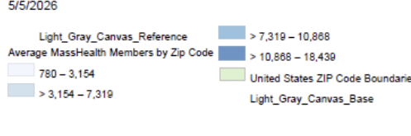
Average Number of MassHealth Members by Zip Code
Highest enrollment = 01605, 01604, 01610
  Burncoat
  Greendale
  Indian Lake
Lowest enrollment = 01608
  Downtown
  Main South
Notes:
There are 7 other zip codes with reported fewer enrollment numbers than 01608 (i.e., 01601, 01611, 01613, 01614, 01615, 01653, 01655)

Slide 6
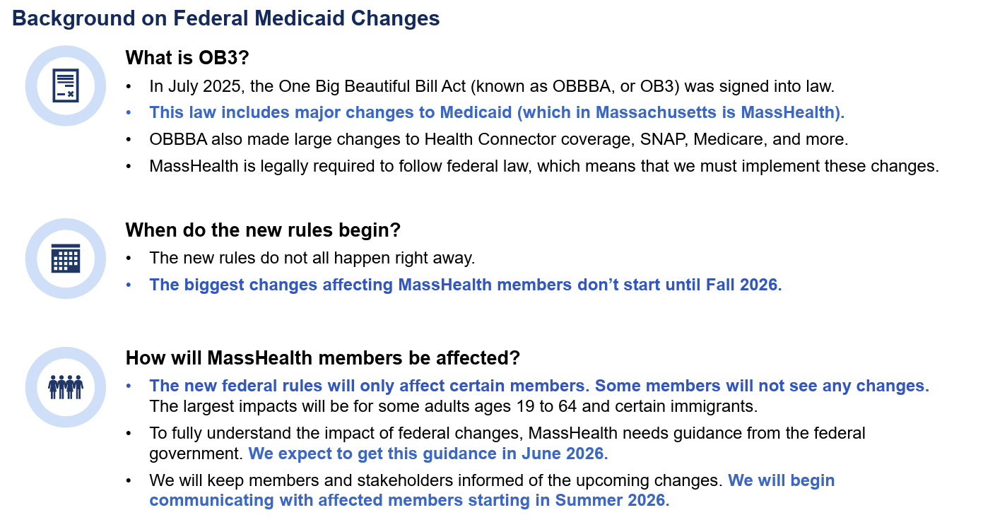
From Mass.Gov Feb 2026
Source: Impact of OB3 on MassHealth for Stakeholders & Partners - Feb 2026.pdf

Slide 7
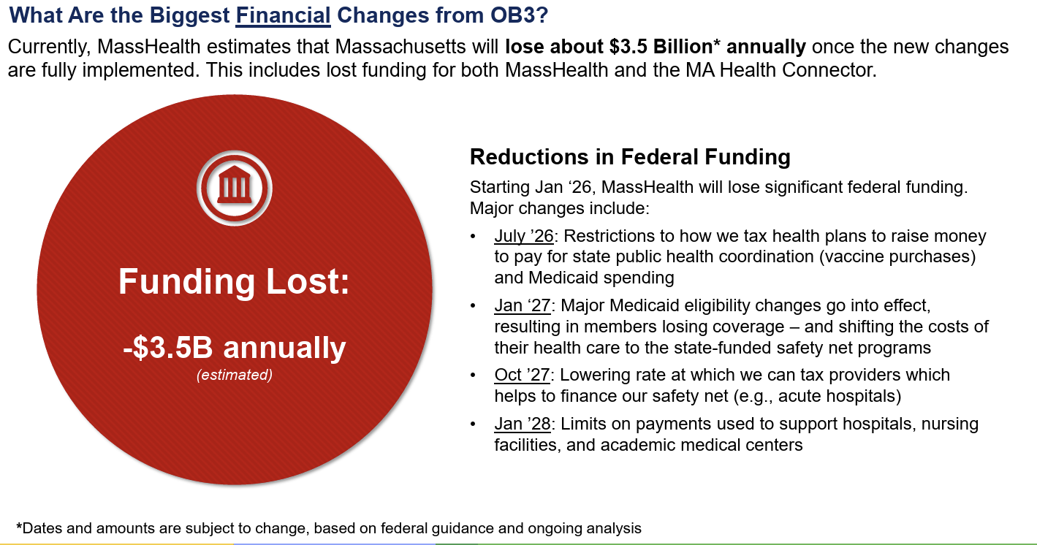
From Mass.Gov Feb 2026
Policy Change and Funding Impact Timeline
Source: Impact of OB3 on MassHealth for Stakeholders & Partners - Feb 2026.pdf

Slide 8
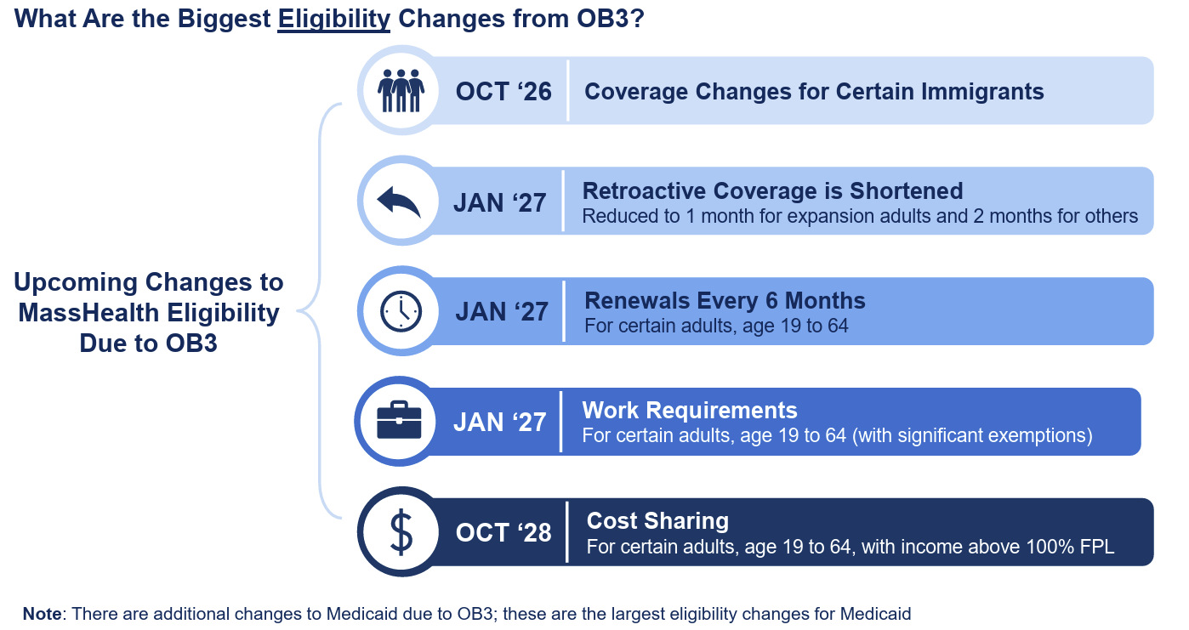
From Mass.Gov Feb 2026
Source: Impact of OB3 on MassHealth for Stakeholders & Partners - Feb 2026.pdf

Slide 9
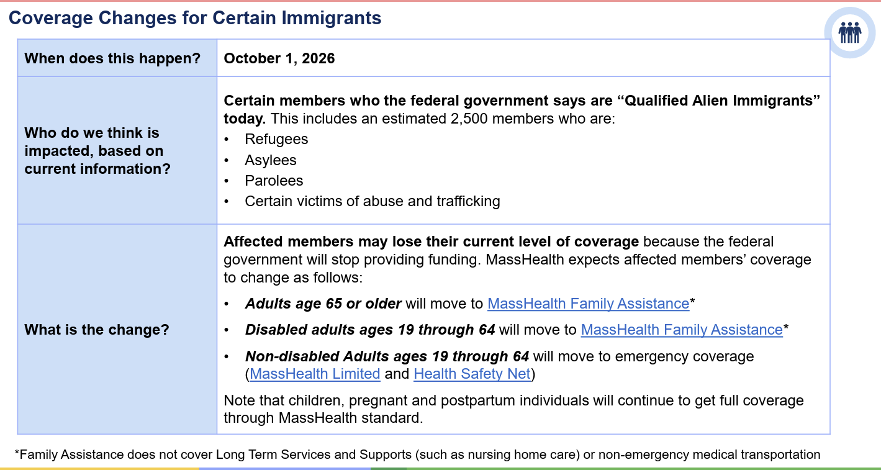
From Mass.Gov Feb 2026
Source: Impact of OB3 on MassHealth for Stakeholders & Partners - Feb 2026.pdf

Slide 10
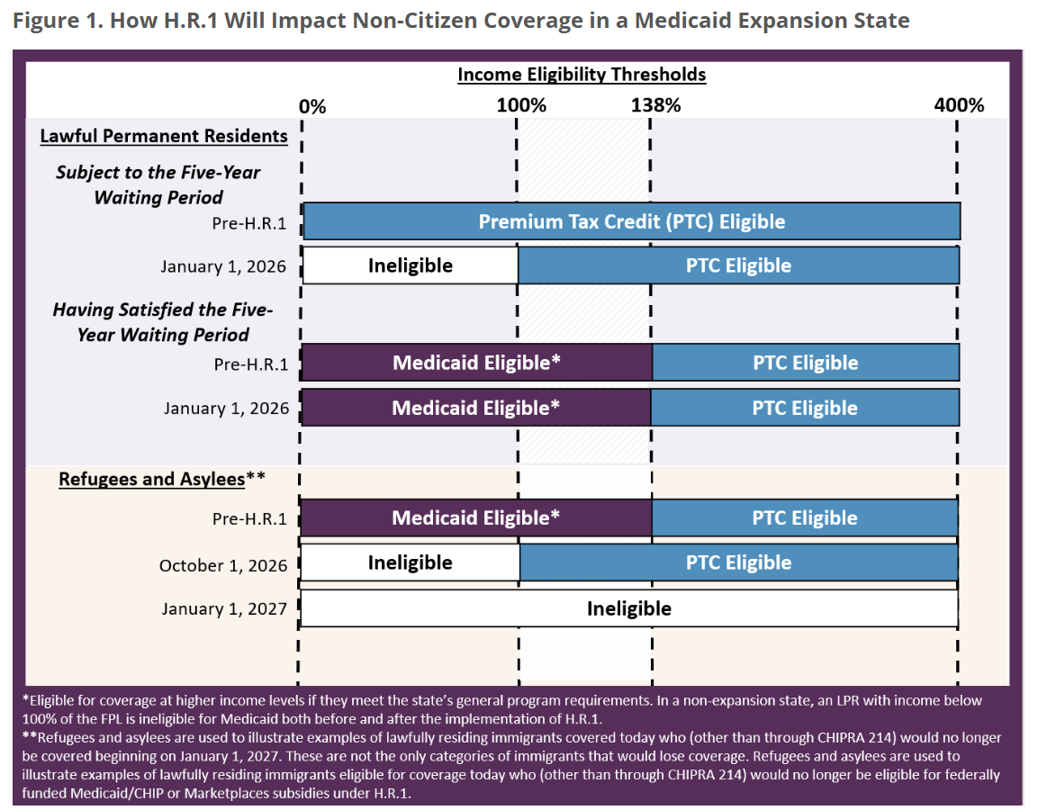
People with green cards (called Lawful Permanent Residents, or LPRs) can still get help paying for Marketplace insurance if they earn more than 100% of the Federal Poverty Level (FPL). They can also get Medicaid or CHIP after they have lived in the U.S. for five years. But starting January 1, 2026, people earning less than 100% of the FPL would no longer be able to get this help. This means low-income LPRs may have no affordable health coverage while they wait to qualify for Medicaid or CHIP. Refugees and people seeking asylum (and other immigrants who are legally in the U.S.) would lose Medicaid or CHIP starting October 1, 2026. They could still get some help paying for Marketplace insurance for a short time through the end of that year. But starting January 1, 2027, they would also lose that help. This would likely leave many of them without affordable health insurance.
Source: State Health and Value Strategies. RWJF. Sept 2025. How H.R.1 Impacts Coverage for Non-Citizens

Slide 11
SNAP Overview
Sources: Center on Food & Equity
Mass Law Reform Institute
MA Department of Transitional Assistance

Slide 12
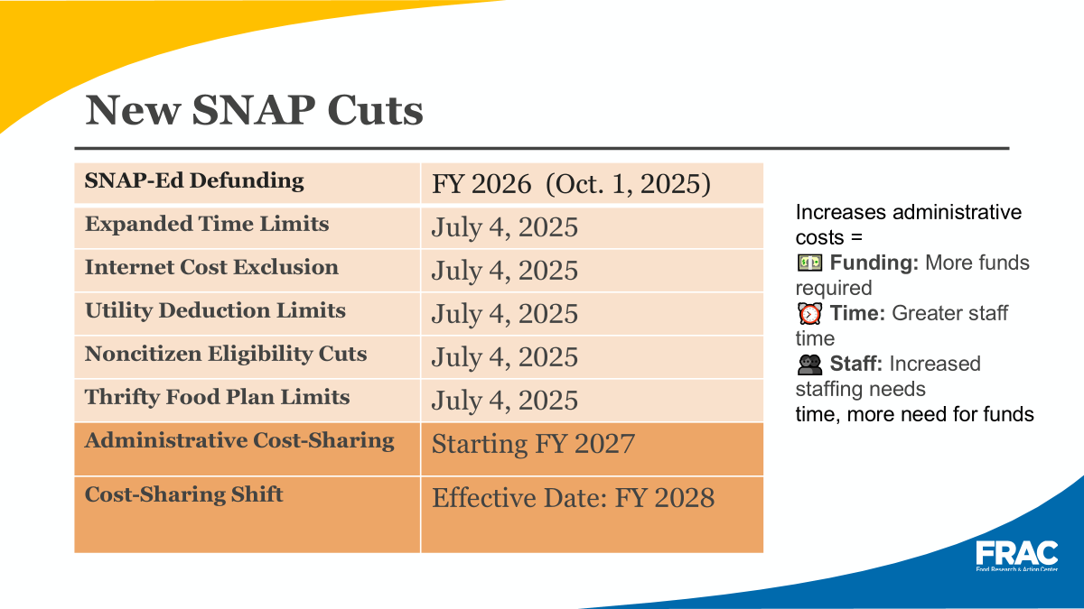

Slide 13
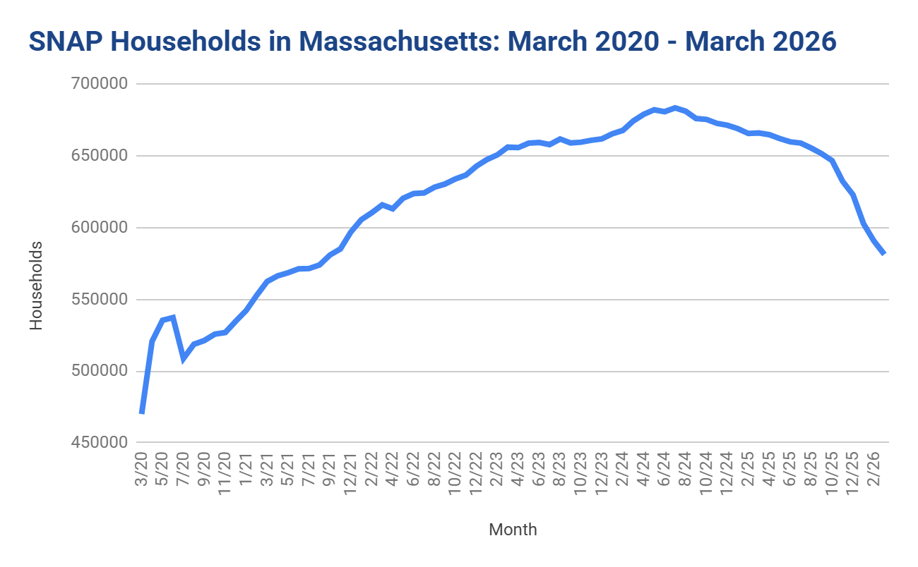

-100,000 households - 15% decline is 2X national average.* Severe decline even though food insecurity, emergency food demand, & cost of living all high/increasing
Data from DTA Scorecards and USDA FNS.
*National data available through Jan. 2026.

Slide 14
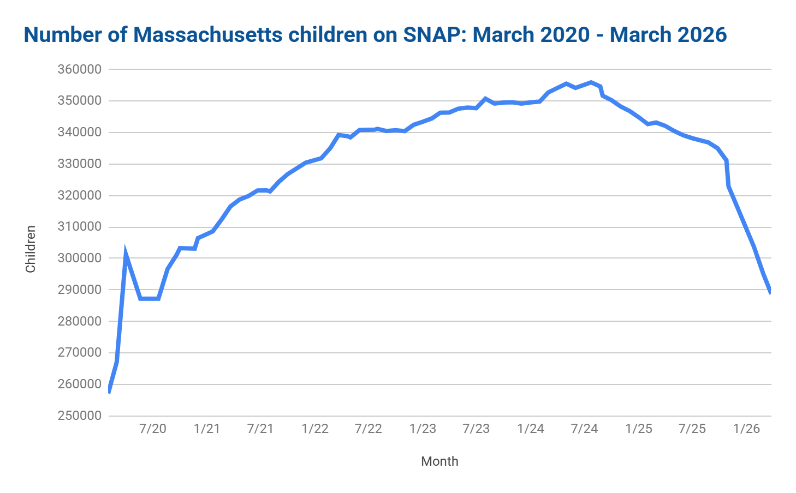
66,000 fewer kids on SNAP - a 19% decline
Data from DTA Scorecards

Slide 15
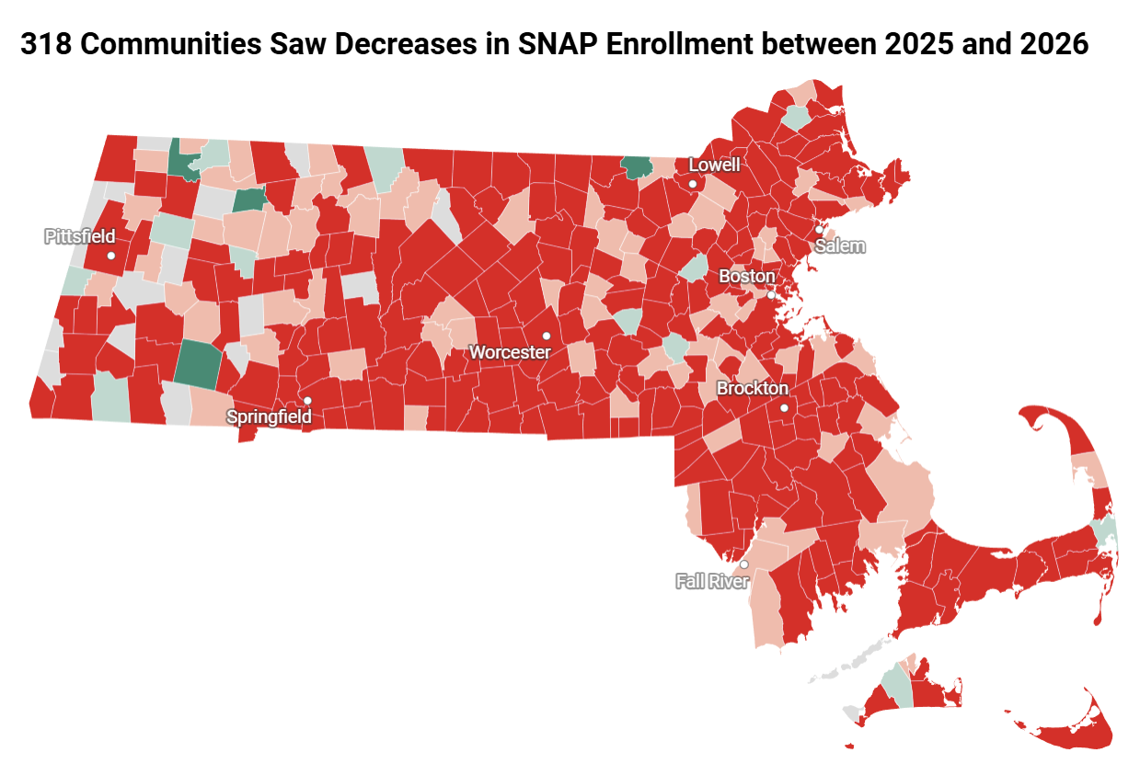
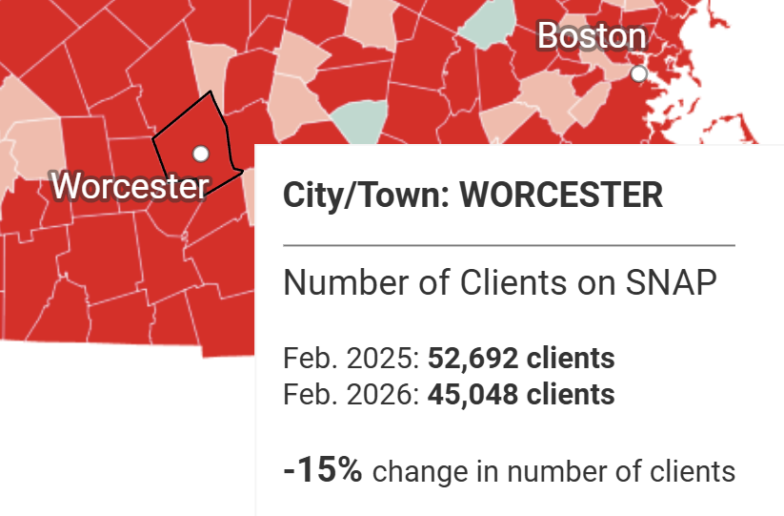


Slide 16
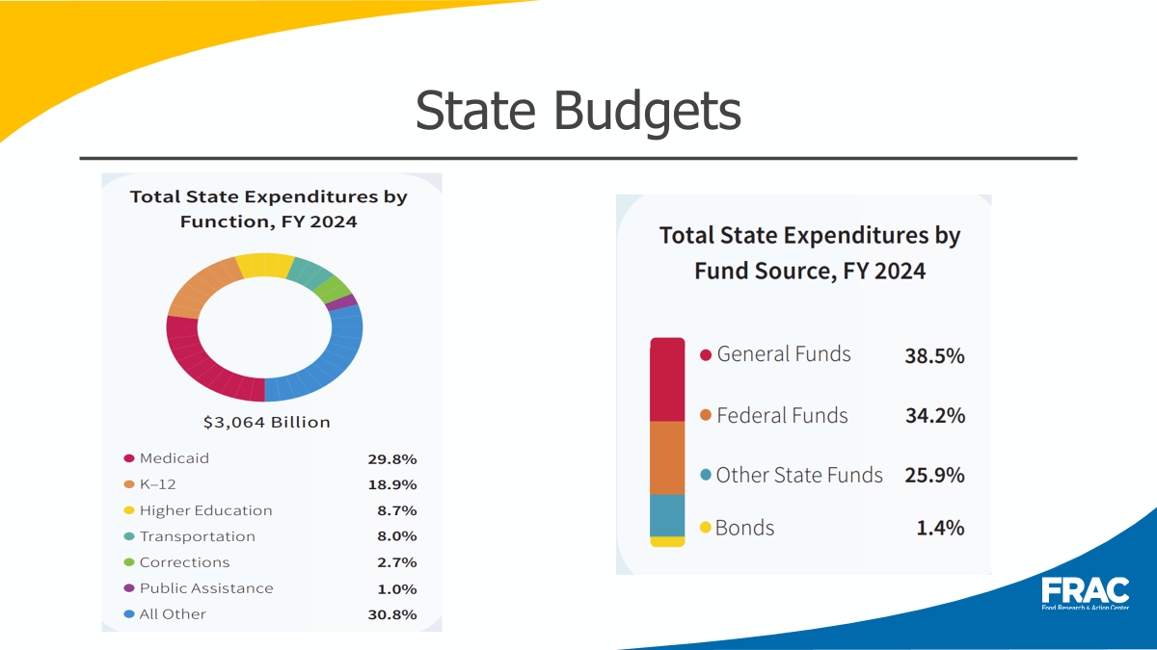


Slide 17


Slide 18
Urgent Need to Invest in More SNAP Caseworkers:
Unprecedented Barriers to Access
The Governor’s FY27 budget (H.2) continues level funding.
  The $147.7M proposed (4400-1100) covers the existing number of caseworkers, including the class of 76 workers hired at the end of 2025 & the 40 positions DTA is currently hiring to backfill. See FY26 projected caseworker spending - just $5M less than H.2. proposal.
House Ways and Means cut funding by $26 million (see context here)
The need: Approx. 200 workers to improve access. Cost of approx. $30M for a full fiscal year - total of $178M for FY27.
The Senate Ways and Means keeps same funding as the Governor’s budget.
May 6, 2026

Slide 19
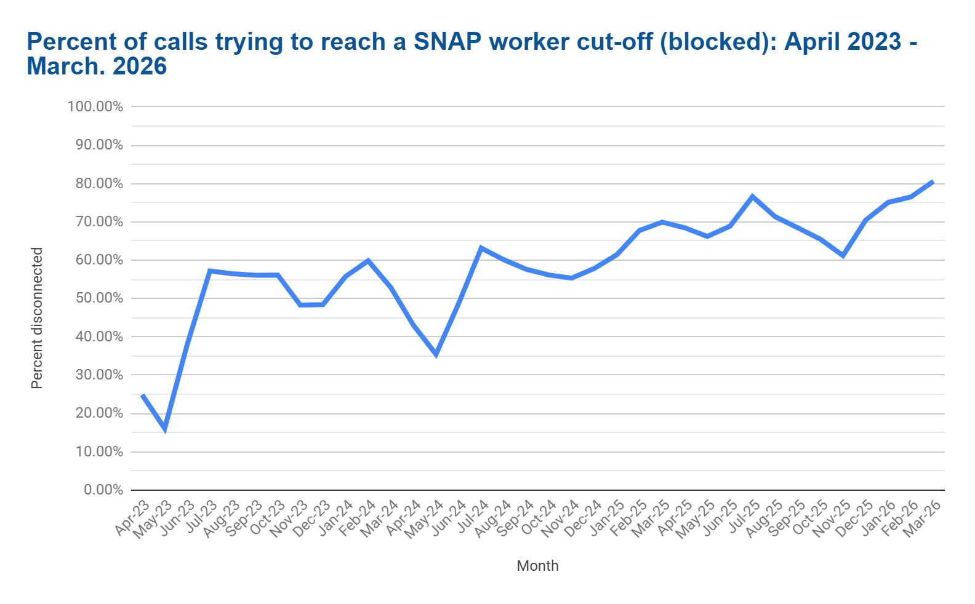
81% blocked in March 2026
Re-start interview for most recertifying, May 1 re-start to 3 month time limit
DTA starts to implement H.R.1. eligibility cuts
Re-start interview for all applicants
Data from DTA Scorecards

Slide 20
Housing Overview
Sources: Central MA Housing Alliance

Slide 21
The Impact of HR1 Procedural Requirements on People Experiencing Homelessness
People experiencing homelessness often depend on Medicaid and SNAP for health care and food, and in some states, housing-related support.
This makes them especially vulnerable to new eligibility and reporting requirements.
Many unhoused individuals face major barriers to completing procedural requirements, including:
  No stable mailing address
  Limited or no access to technology needed for reporting
  Difficulty managing paperwork while living without stable housing
Many also experience mental and physical health challenges, making complex systems even harder to navigate.
As a result, Medicaid renewals and work requirements could cause many unhoused individuals to lose access to these essential benefits.
Impacts informed by Homebaseccc.org HR1 Analysis https://acrobat.adobe.com/id/urn:aaid:sc:VA6C2:250066d9-7868-4919-98fd-3bc924f2e4ef?x_api_client_id=edge_extension_viewer&x_api_client_location=share

Slide 22
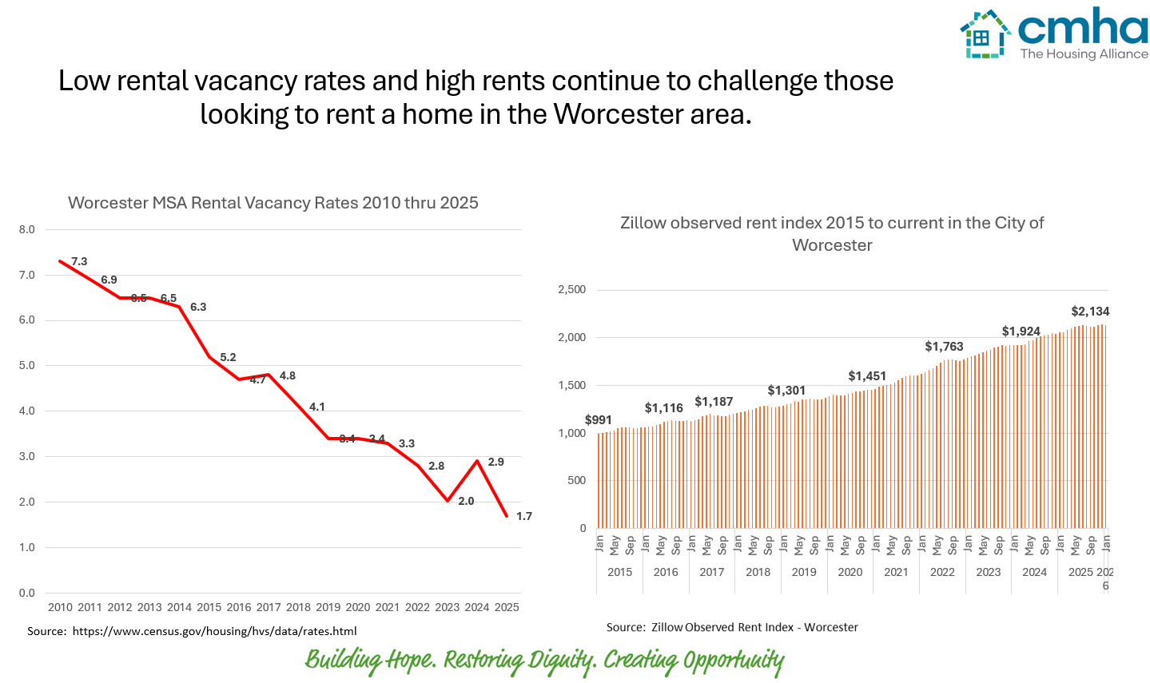
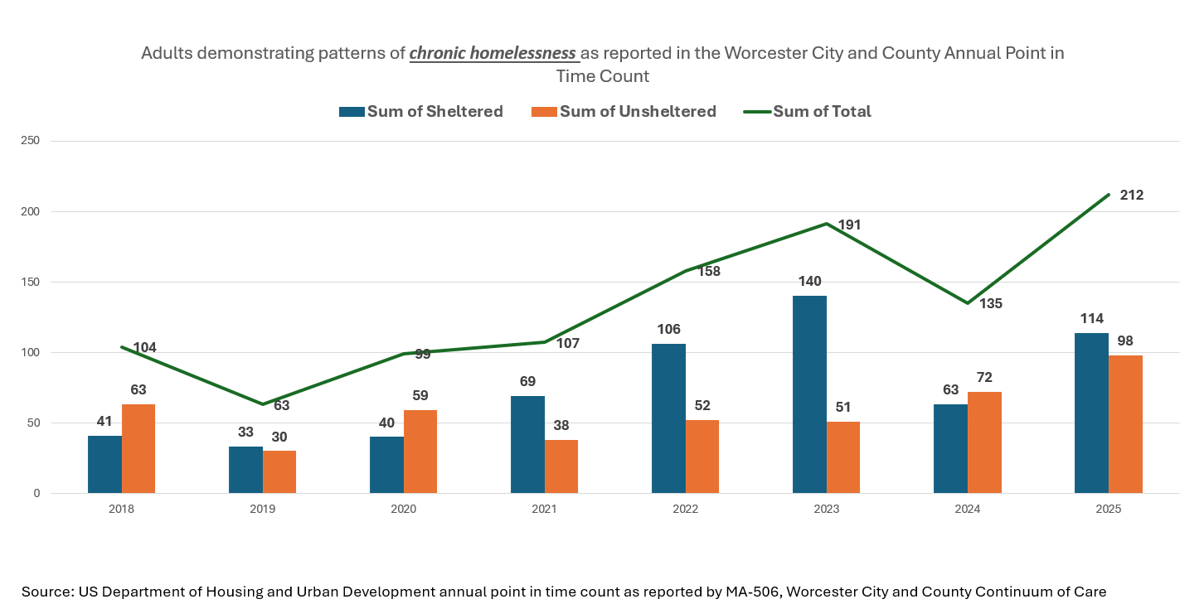
Local rental vacancy rates and high rent continue to challenge those looking to rent a home the Worcester area. Simultaneously, chronic homelessness is on the rise. Given HR1, already vulnerable populations are at higher risk of destabilized housing and homelessness.

Slide 23
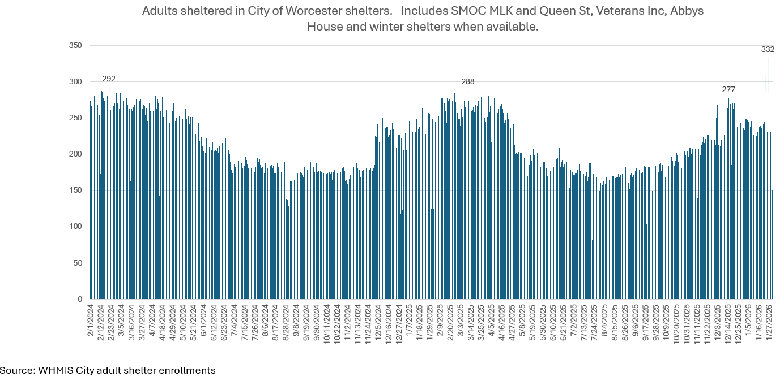
There has been a 19.86% increase in adults sheltered in City of Worcester shelters between 12/01/25 - 01/27/26. There is an anticipation of this increase by Winter 2026 in lieu of HR1 policy changes going to into effect. This will be paired with eligibility changes in MassHealth.

Slide 24
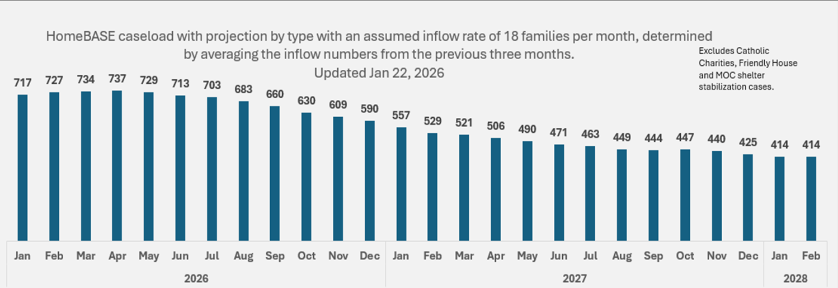
CMHA HomeBASE Caseload and Projections through Feb 2028

Slide 25
MA Changes to HomeBASE Eligibility
Key Changes and Eligibility Requirements (2025-2026):
Pause on Third Year: The state has paused approvals for the third year of HomeBASE support, aiming to focus on the most critical needs.
Income Limits: Eligibility is aligned with EA guidelines, which require household income to be at or below 200% of the Federal Poverty Level.
Eligibility Pathways: Families must be eligible for the Emergency Assistance (EA) shelter system. This includes "Front Door" (homeless), "Back Door" (in shelter), or "Side Door" (domestic violence shelters) access points.
Over-Income Rule: If income exceeds the limit while receiving benefits, families may continue to receive assistance for 12 months, provided they are complying with a stabilization plan.
Proposed Changes: The administration has proposed lowering total benefits to $25,000 per year for two years, shifting away from the previous $30,000 over two years ($45,000 over three) to manage costs
Source: HB Admin Plan_March 2026.pdf

Slide 26
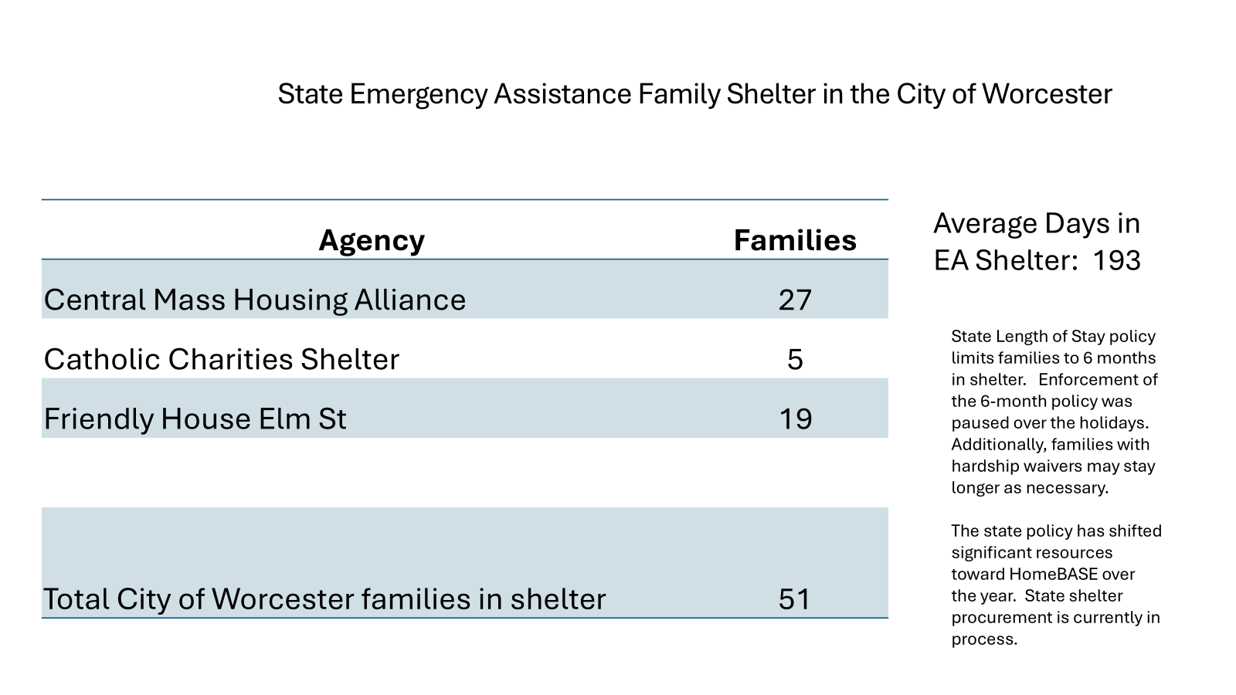

Slide 27
Current capacity of EA Family Shelters in the City of Worcester
City of Worcester
Organization Name | Project Name | Units HH w/ Children | Beds HH w/ Children
Catholic Charities - Worcester EA Total |  | 12 | 35
Central Mass Housing Alliance EA Total |  | 131 | 423
Friendly House EA Total |  | 53 | 186
SMOC EA Total |  | 49 | 198
Grand Total |  | 245 | 842
About half of SMOC's EA units are in Milford.

Slide 28
2025 Massachusetts Changes in EA Family Shelter Eligibility
Key 2025 EA Shelter Eligibility & Policy Changes
Length of Stay Reduction: Effective early 2025, the maximum stay for families in the EA Family Shelter program was reduced to 6 months (down from 9).
Work/Activity Requirement: Adults in the household must participate in at least 30 hours per week of "self-sufficient activities," such as employment, education, training programs, or community service.
New Residency & Status Requirements: Each family member must be a Massachusetts resident and at least one child under 18 must have lawful immigration status.
Capacity Limits: A cap of roughly 3,200 to 5,800 families was enforced throughout 2025, with a cap of 4,000 families authorized for Dec 31, 2025, through Dec 31, 2026.
Bridge Shelter Track: The primary, 6-month shelter model, focusing on moving families to stable housing.
Hardship Waivers: Extensions of up to 35 days (hardship) or 42 days ("lease bridge") may be available if housing is secured but not yet accessible.
Safety & Compliance: New requirements mandate criminal background checks (CORI).
Application and Process: Families must prove they are residents of Massachusetts, intending to stay, and provide documentation for all household members over 18, according to the EA Family Shelter Policy Changes
Source: https://www.mass.gov/doc/ea-family-shelter-policy-changes-42025/download

Slide 29
Opportunities to Mitigate the Impact on People Experiencing Homelessness
While many of these changes won’t happen for months or years, there are steps that Continuums of Care, homeless services providers, and others can take today to mitigate H.R.1’s harm to people experiencing homelessness:
Explore how the data collected on clients’ disability status, medical status, participation in drug and alcohol treatment programs and more can be used to meet exemptions.
Explore how the information collected on clients’ income, workforce training, community service or educational activities could be used to meet work requirements.
Explore ways that participation in programs could help clients meet work requirements.
Build on existing partnerships with workforce agencies and training programs to support employment.
Explore data sharing with local or state Medicaid agencies to streamline reporting requirements for clients.
Engage in local or state advocacy efforts to help shape the implementation of these programs.
Stay informed to better help clients meet the new work and renewal requirements when they begin.
Recommendations informed by Homebaseccc.org HR1 Analysis https://acrobat.adobe.com/id/urn:aaid:sc:VA6C2:250066d9-7868-4919-98fd-3bc924f2e4ef?x_api_client_id=edge_extension_viewer&x_api_client_location=share

Slide 30
Refugee and Immigrant Overview
Sources: U.S. Census
UMass Donahue Institute
Worcester RISE for Health

Slide 31
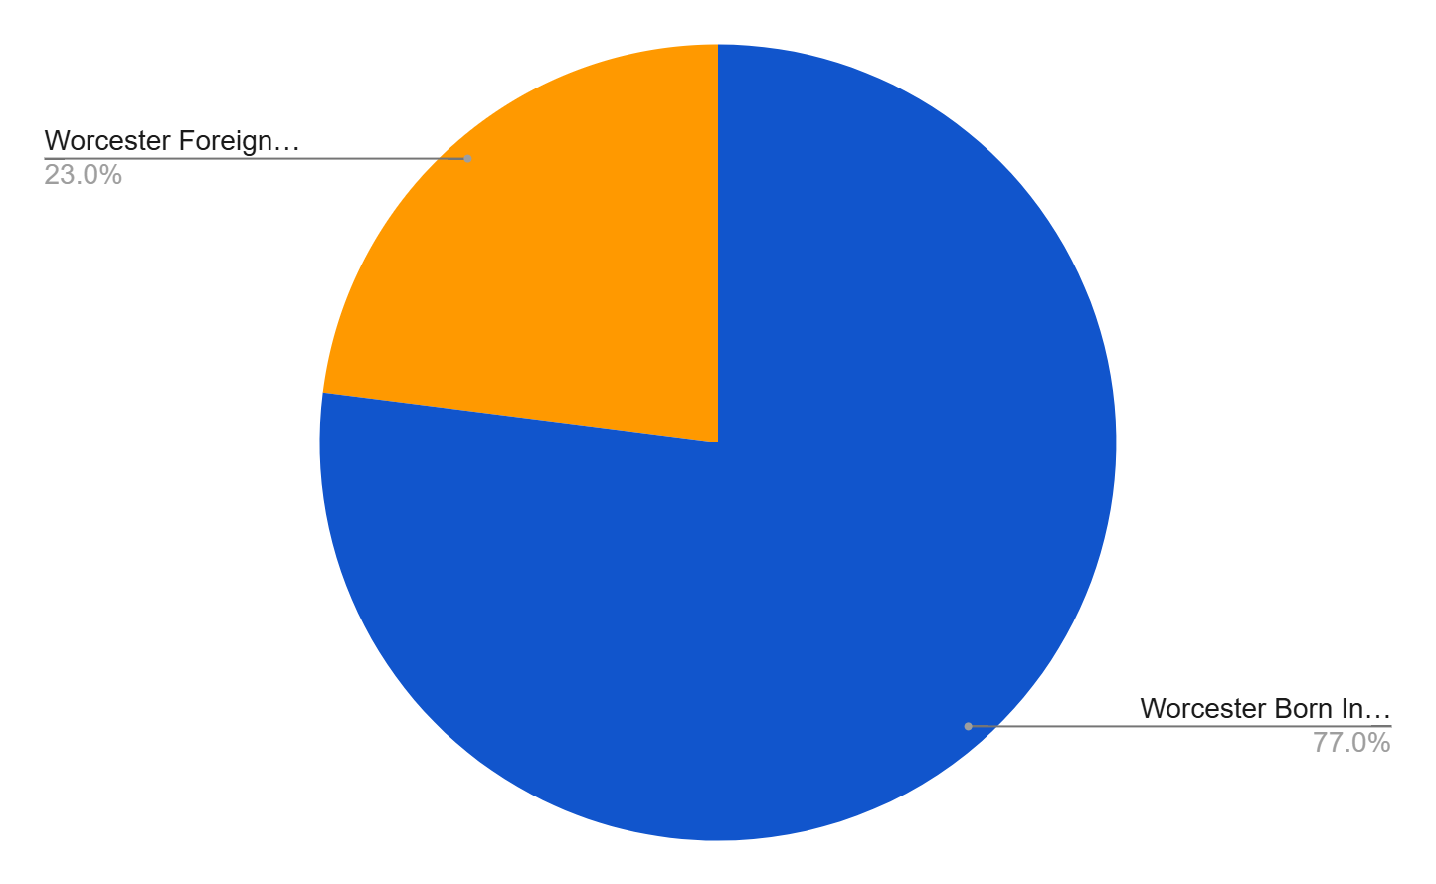
Population Data
Worcester Total Population
211,286
(U.S. Census Bureau, 2024)
Worcester Foreign-Born Population 23%
(U.S. Census Bureau, 2024)
Worcester Born in U.S. Population 77%
(U.S. Census Bureau, 2024)

Slide 32
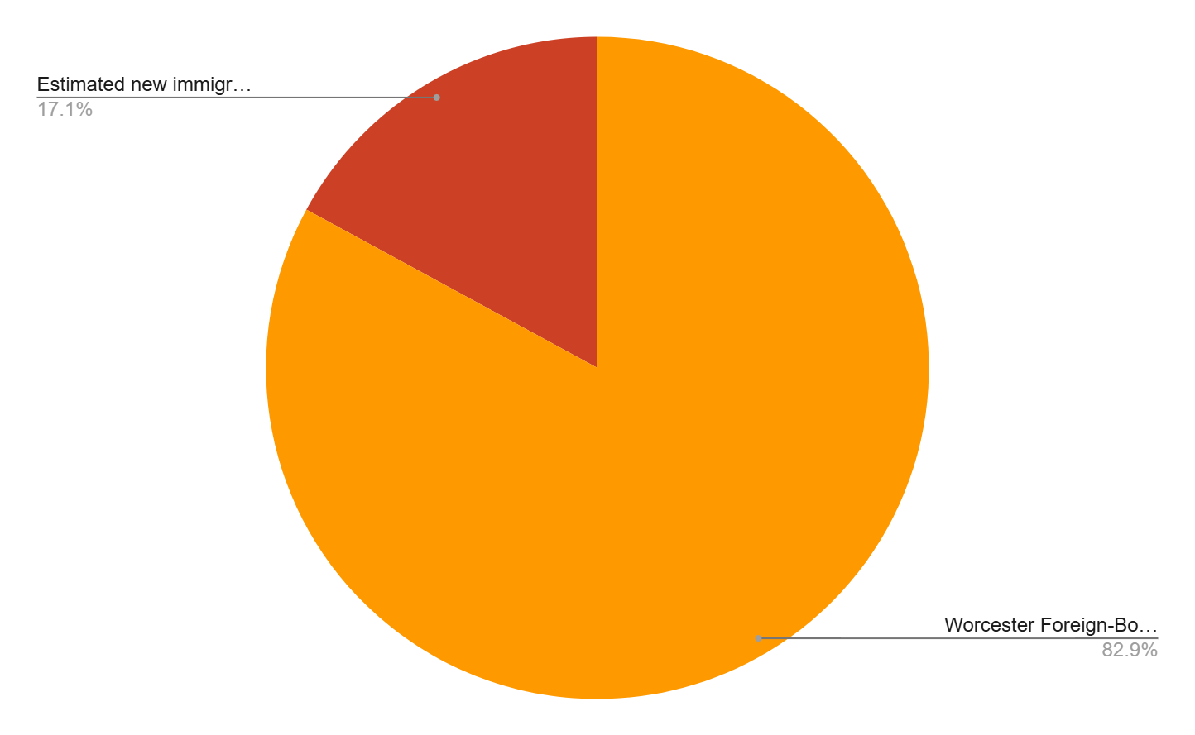
Population Data
Data estimates derived from
U.S. Census Bureau, 2024
UMass Donahue Institute
Worcester RISE for Health
Of total foreign-born in Worcester,
17.1%
are estimated to have arrived between 2021-2025
*Disaggregated data across documentation status (i.e. seeking asylum, asylum granted, green card status, etc.) and country of origin needed
Estimated foreign-born in Worcester who arrived before 2021
82.9%

Slide 33

Understanding Vulnerabilities and Challenges
warning
Refugees and Immigrant Groups face disproportionate challenges across MassHealth, SNAP, and housing
Safety & Legal Hardships
Benefits, Housing & Policy
•ICE enforcement & perception of safety in the city
•Deportation, family separation, & trauma
•Financial hardships & rising immigration fees
•Critical need for pro-bono legal advice
•Documentation: Freezes/delays in Washington causing initial docs to lapse
•SNAP/Health: Loss of SNAP benefits & looming Medicaid cuts
•Housing: Huge challenges with EA and Home Base
•Employment: Secondary impact from documentation delays

